Slide 1
Chips Category Strategy: Insights from Our Latest Analysis
June 2020
Retail Analytics
Brand note: If client logo is not required, use alternate title page layout right click slide thumbnail > Layout > Title
Presented by: Swaraj Borhade
Date: June 2025

Slide 2
Notes:
To view Privacy video explaining how important data privacy is to Quantium, please click here: https://www.youtube.com/watch?v=Zq1QDAkoRzU
or here Q:\Company Reference\Brand & Design\Brand videos\Q Privacy.mp4
At Quantium, we believe that data is the behavioural footprint of humanity and that it has to be treated with the utmost care and responsibility.
Histories, attitudes, indeed lives are stored within it in ways that aren’t always apparent – and that’s what makes its potential so powerful.
To work with it responsibly, sensitively, we set ourselves the highest data privacy protection and governance standards.
We have spent 17 years perfecting privacy-by-design and secure-by-design principles. Central to this is not holding any personally identifiable information about people –
we neither receive it, and put the necessary protections in place to be unable to decipher it.
Every aspect of handling data is safeguarded: from its de-identification, to its encryption – data security is paramount and of the highest grade.
We pride ourselves on gaining the trust of iconic organisations around the world through years of securely working with their data,
and in turn the trust that builds with their stakeholders.

Slide 3
Executive summary
01
Task 1
Here you will include your high-level findings and any key callouts for task 1
02
Task 2
Here you will include your high-level findings and any key callouts for task 2

Slide 4
01
Category
"We've found that Older Families and Young Singles/Couples, especially those buying Mainstream and Premium chips, are our most valuable customers."
"Understanding these key groups helps us target our efforts better."

Slide 5
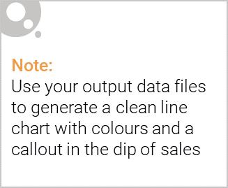
Overview: your key callout for the category should be included here
LIFESTAGE: Young Singles/Couples, Midage Families, Retirees, etc.
PREMIUM_CUSTOMER: Budget, Mainstream, Premium
💬 Commentary:
Higher affluence = higher spend (esp. Premium Older Families)
Budget segments purchase frequently but in smaller packs

Slide 6
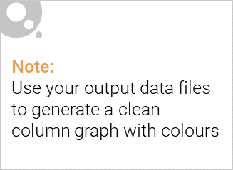
This slide will be commentary on affluence and its effect on consumer buying for the category of chips
Premium customers across most life stages spend more on chips compared to Budget or Mainstream tiers.
Older Families and Retirees in the Premium category are the top spenders, often purchasing larger pack sizes.
Budget segments (especially Young Singles/Couples) show high purchase frequency, but with smaller pack sizes and lower spend per transaction.
Midage and New Families in the Mainstream tier also present steady spend, but with less variation in pack size.
Marketing and promotional strategies should prioritize Premium customers for value growth and Budget customers for volume growth through trial packs or offers.

Slide 7
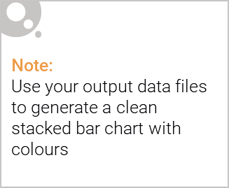
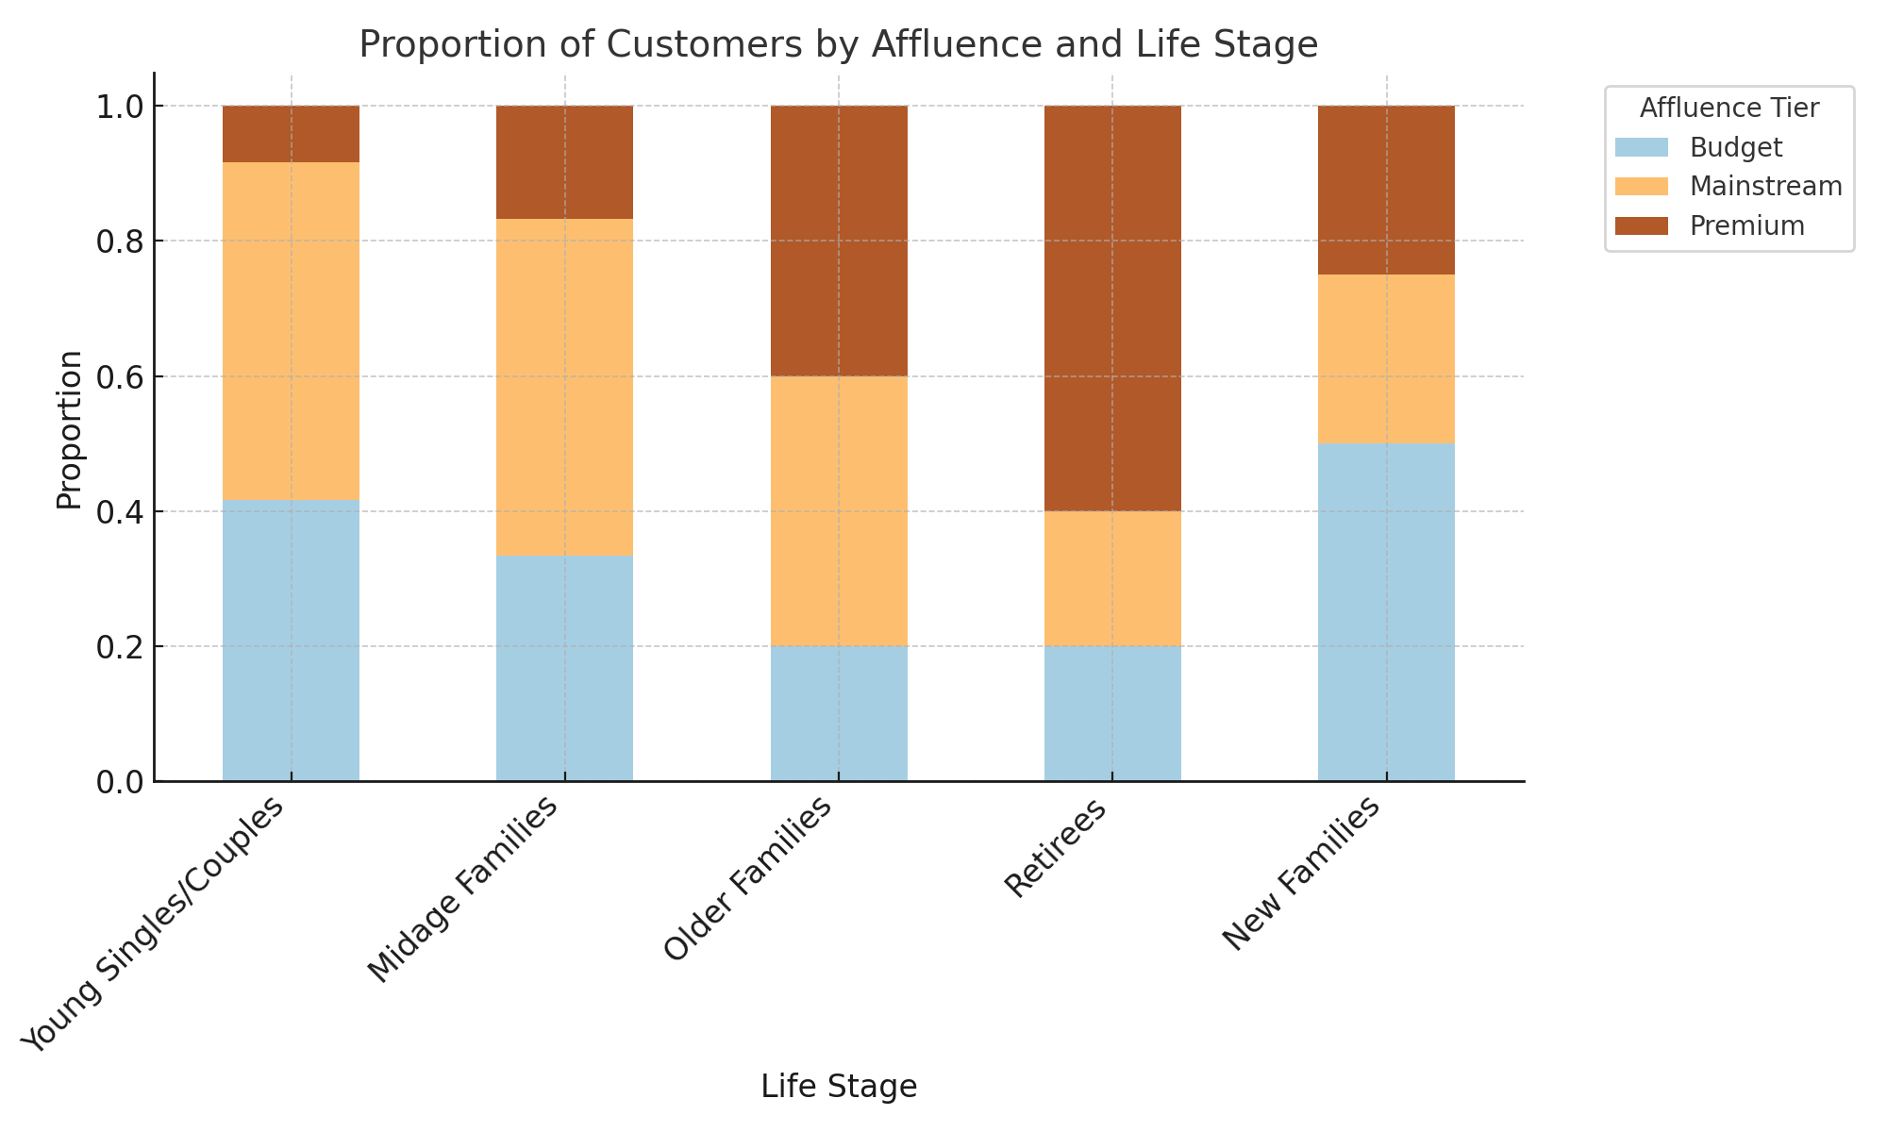
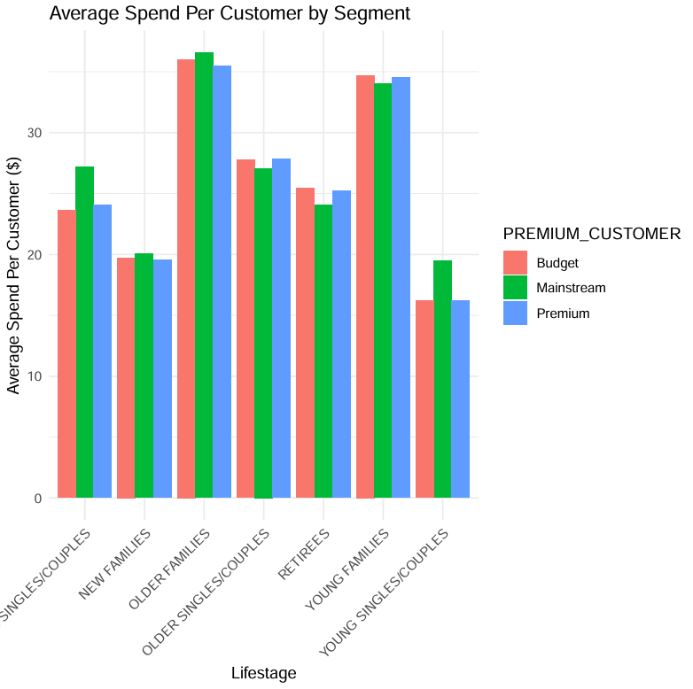
Editable (delete this)
Stretch: Try visualising the proportion of customers by affluence and life stage on this slide

Slide 8
02
Trial store performance
If the trial was successful: "The recent trial in Store 77 significantly increased both sales and customer numbers, proving the effectiveness of our strategy."
If the trial was not successful: "The recent trial in Store 77 showed only minor changes in sales and customer numbers, suggesting it didn't have a large impact."

Slide 9
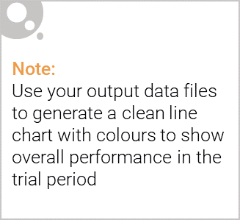
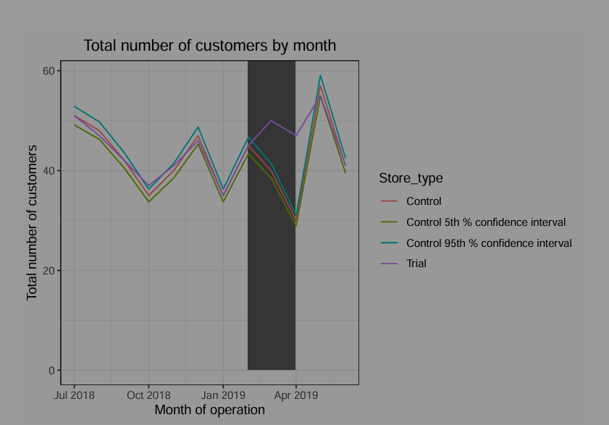
Explanation of the control store vs other stores
Purpose: To show the trial's impact on sales, comparing the trial store to the scaled control store and its expected range.
Suggested Type: Line Chart with Points, with a shaded background or vertical lines to highlight the trial period (Feb-Apr 2019).
Data Source: Your trial Assessment Sales data from Task 2.
Appearance:
X-axis: Month of Operation (full period, e.g., June 2018 - May 2019).
Y-axis: Total Sales ($).
Series: "Trial Store" (red, solid line), "Control Store" (blue, solid line), "Control 95th % confidence interval" (dark green, dashed line), "Control 5th % confidence interval" (dark green, dashed line).

Slide 10
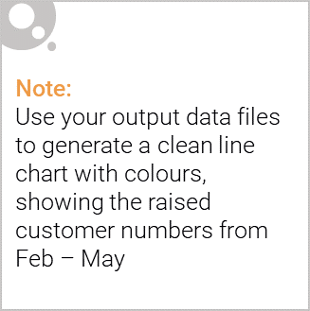
Call out of the performance in the trial store, determining if it was successful
Purpose: To show the trial's impact on customer numbers, comparing the trial store to the scaled control store and its expected range.
Suggested Type: Line Chart with Points, with a shaded background or vertical lines to highlight the trial period (Feb-Apr 2019).
Data Source: Your trialAssessmentCust data from Task 2.
Appearance:
X-axis: Month of Operation (full period).
Y-axis: Total Number of Customers.
Series: "Trial Store" (red, solid line), "Control Store" (blue, solid line), "Control 95th % confidence interval" (dark green, dashed line), "Control 5th % confidence interval" (dark green, dashed line).

